Slide 1

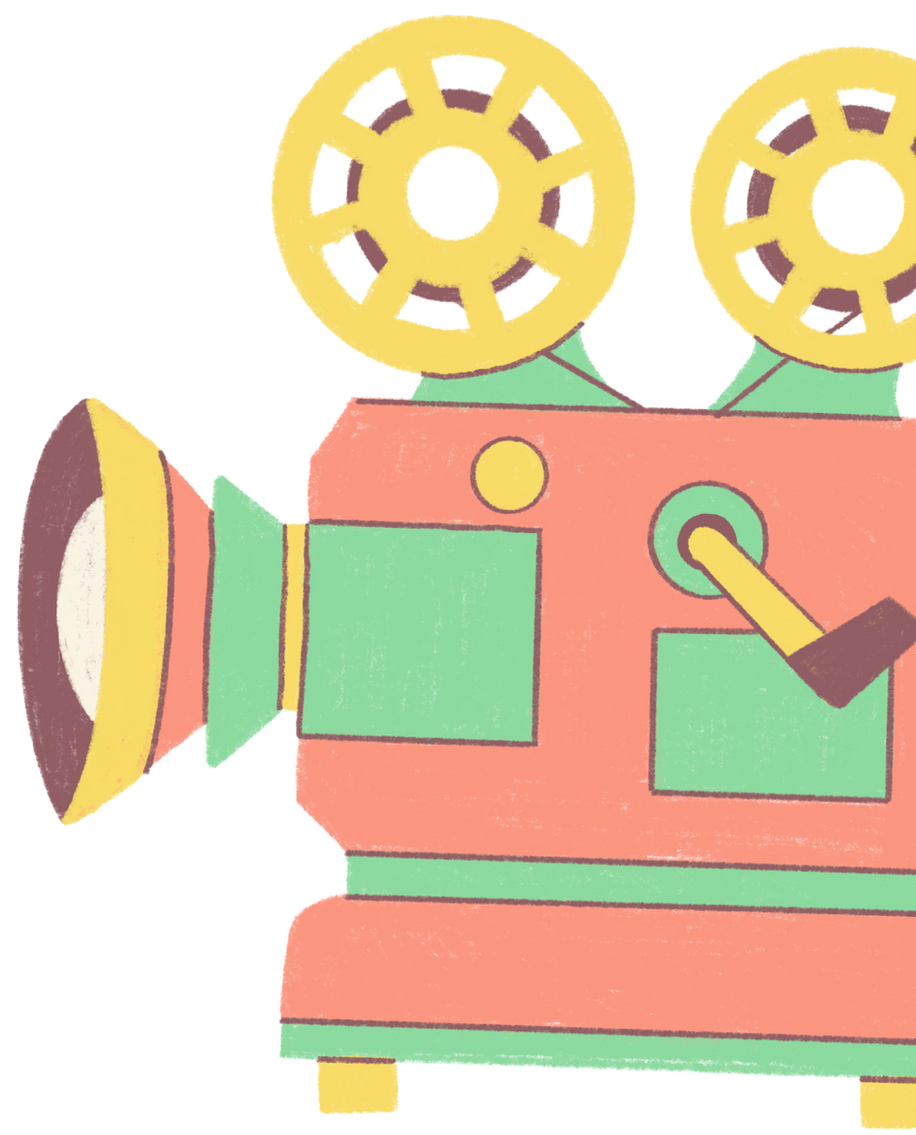


Movie Recommendation System

Slide 2






Team Members:
Kamalika Saha(LEADER)
Sweety Nag
Monami Ghosh
Greeny Kundu
Priyadarshini Sen
Annesha Basu

Slide 3


What is machine learning?
Machine learning (ML) is a field of inquiry devoted to understanding and building methods that "learn" – that is, methods that leverage data to improve performance on some set of tasks. It is seen as a part of artificial intelligence. Machine learning algorithms build a model based on sample data, known as training data, in order to make predictions or decisions without being explicitly programmed to do so.
In its application across business problems, machine learning is also referred to as predictive analytics.

Slide 4
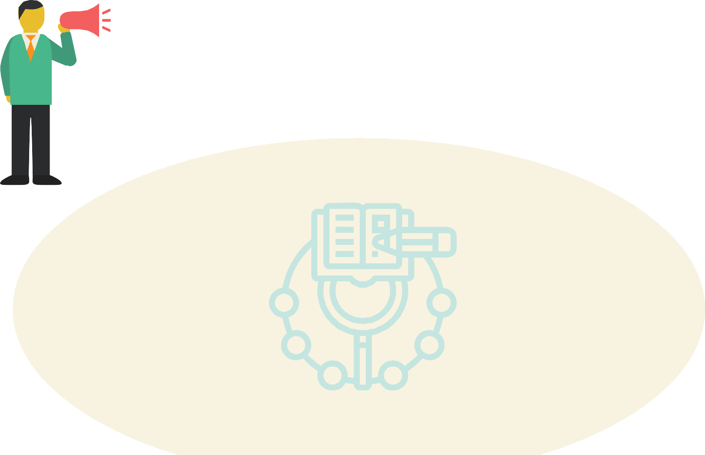

Introduction:
A recommendation system is a type of information filtering system which attempts to predict the preferences of a user y,and make suggestion based on these preferences. For E.g people who buy the Apple MacBook also buy a USB-C to USB Adapter ,they can recommend the Adapter to an user who a MacBook to his cart.
TensorFlow is a free and open-source software library for machine learning and artificial intelligence. It can be used across a range of tasks but has a particular focus on training and inference of deep neural networks.

Slide 5
Types of Recommendation System:
Recommendation System
Content Based Filtering
Collaborating Filtering
Hybrid reccomendation
Item data focused
User dats focused
Uses both item and user data

Slide 6


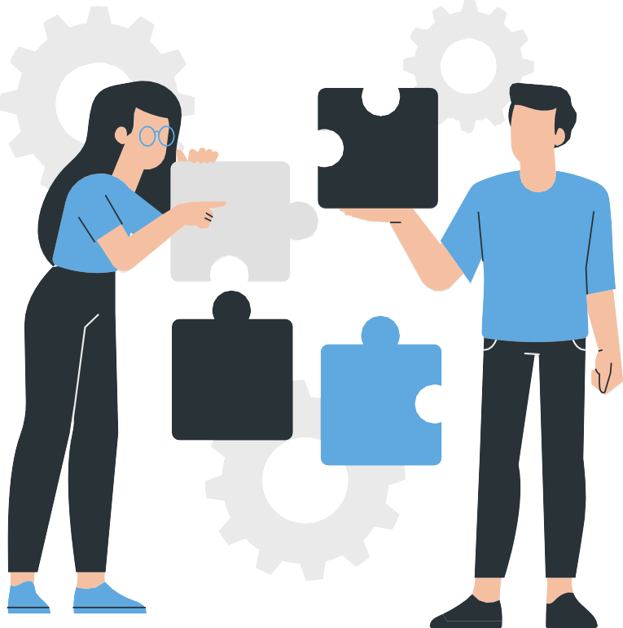
Problem Statement:
The problem statement for the movie recommendation project using TensorFlow is to build a recommendation system that can suggest movies to users based on their viewing history and preferences.
The system needs to analyse the user's behaviour, such as what movies they have watched, rated, or commented on, and provide recommendations for similar movies they may like.
The system should consider various factors such as movie genre, cast, director, rating, and user viewing history to generate relevant and accurate recommendations. Additionally, the system should be scalable, efficient, and able to handle a large volume of data. The ultimate objective is to develop a recommendation system that provides a high-quality user experience and drives user engagement on the platform

Slide 7
Challenges:
Cold start problem: This occurs when a new user joins the platform and has no viewing history. In this case, the system has no data to use in generating recommendations for the user.
Data sparsity: Users may not provide sufficient ratings or feedback on movies, leading to sparse data. Sparse data can make it challenging for the system to provide accurate recommendations.
Privacy concerns: Recommendation systems often involve collecting and processing user data, which can raise privacy concerns. The system must be designed to comply with data protection regulations and ensure user privacy.
Bias: Recommendation systems may suffer from bias, which can affect the accuracy of recommendations. Bias can be introduced at different stages of the recommendation process, including data collection, algorithm design, and output.
Transparency: It can be challenging to explain to users how the system generated a specific recommendation. The system must be designed to be transparent, providing clear explanations how it arrived at each recommendation.
of

Slide 8


Solution Approach:
The solution approach for the movie recommendation project using TensorFlow involves the following steps:
Data pre-processing: The first step is to collect and preprocess the data. This involves gathering data about movies, users, ratings, and comments. The data is then cleaned, transformed, and prepared for use in the model.
Model selection: The second step is to choose an appropriate model for the recommendation system. One approach is to use a deep learning model, such as a neural network, that can learn from the user's behavior and provide personalized recommendations.
Model training: The third step is to train the chosen model using the preprocessed data.
The model is trained to learn the patterns and relationships between users, movies, and ratings.
Model evaluation: The fourth step is to evaluate the performance of the model. This involves testing the model's accuracy in predicting user preferences and recommending relevant movies.

Slide 9
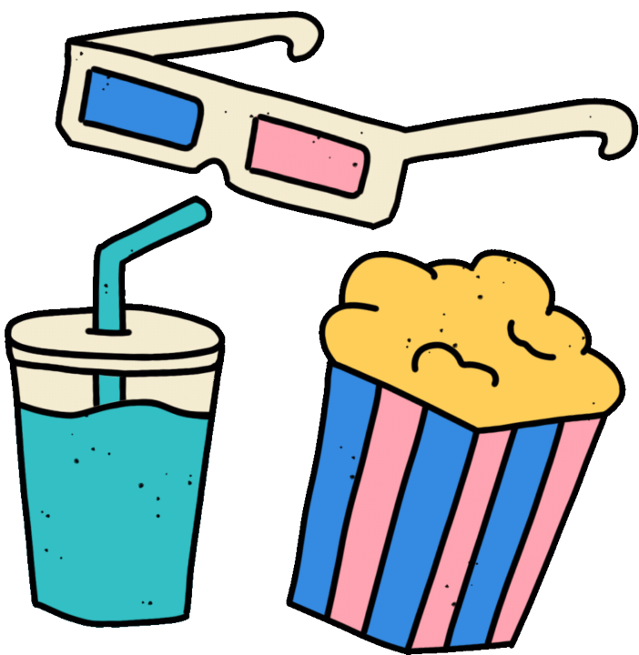
Advantages of movie recommendation system:
Personalization: Movie recommendation systems can suggest movies tailored to the user's interests and preferences, which can enhance the user's overall movie- watching experience.
Time-saving: With the sheer number of movies available, it can be time-consuming to browse through all of them. A recommendation system can save time by suggesting movies that the user is likely to enjoy.
Variety: A movie recommendation system can suggest movies outside the user's typical movie choices, introducing them to new genres, directors, or actors.

Slide 10
Disadvantage of Movie Recommendation:
Limited scope: Movie recommendation systems may only suggest movies that the user has already watched, resulting in a limited pool of recommendations.
Algorithm bias: Movie recommendation systems rely on algorithms that may contain biases and stereotypes, which can result in skewed recommendations that don't reflect the user's true preferences.
Overfitting: Recommendation systems can become
too specialized and make recommendations that are too similar to what the user has already watched, resulting in a lack of variety in recommendations

Slide 11

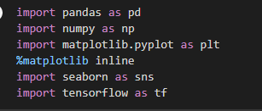



Libraries Used:
The analysis will be done using the following libraries :
Pandas : This library helps to load the data frame in a 2D array format and has multiple functions to perform analysis tasks in one go.
NumPy: NumPy arrays are very fast and can perform large computations in a very short time.
Matplotlib/Seaborn : This library is used to draw visualizations. Tensorflow: This library is a free and open-source software library for machine learning and artificial intelligence. It can be used across a range of tasks but has a particular focus on training and inference of deep neural networks.

Slide 12

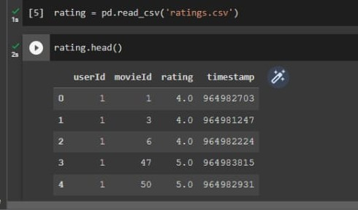
Importing Datasets:
Importing the rating data set which contains ratings given by the users to the movies they watched.

Slide 13
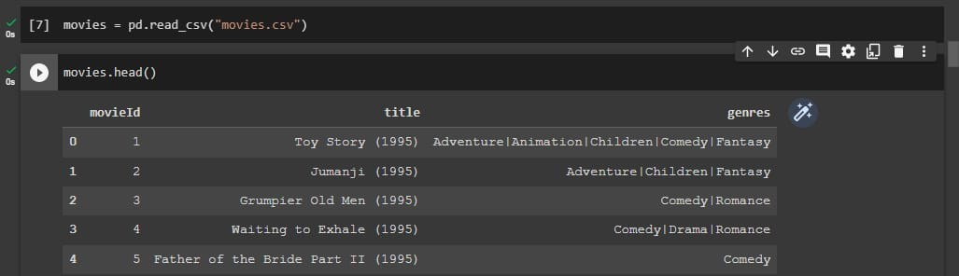
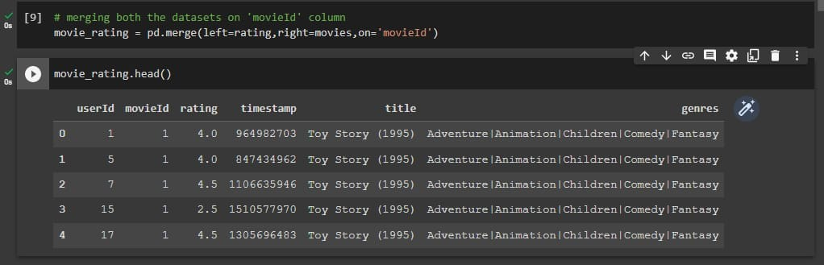

Slide 14

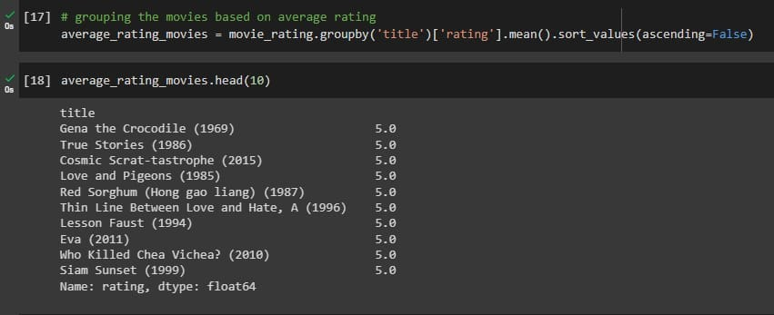
Data Visualization:
Data visualization is the graphical representation of information and data. By using visual elements like charts, graphs and maps, data visualization tools provide an accessible way to see and understand trends, outliers,
and patterns in data.
Additionally, it provides an excellent way for employees or business owners to present data to non- technical audiences without confusion.

Slide 15
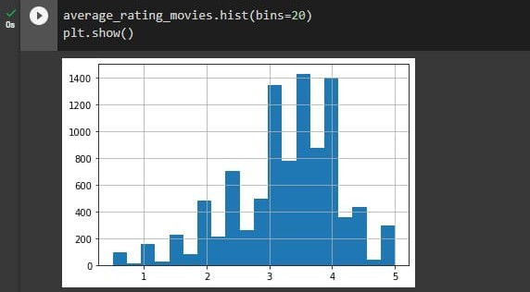
Maximum movies have average rating in the range 3 to 4. The movies which have
average =
5.0 may be the ones which may have been watched once or twice

Slide 16
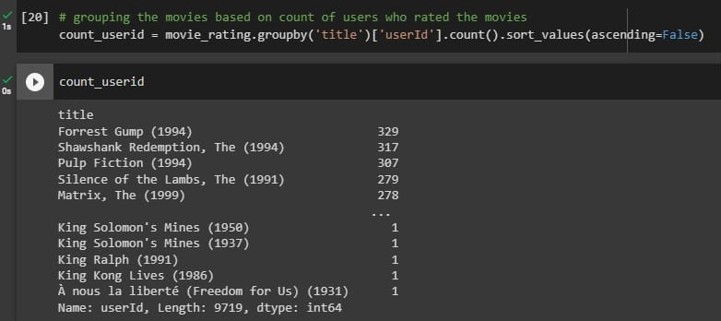

Slide 17
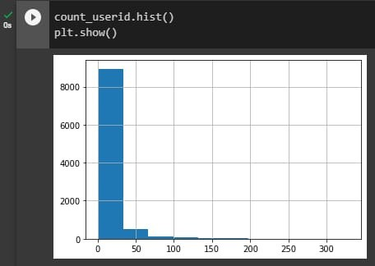

Slide 18


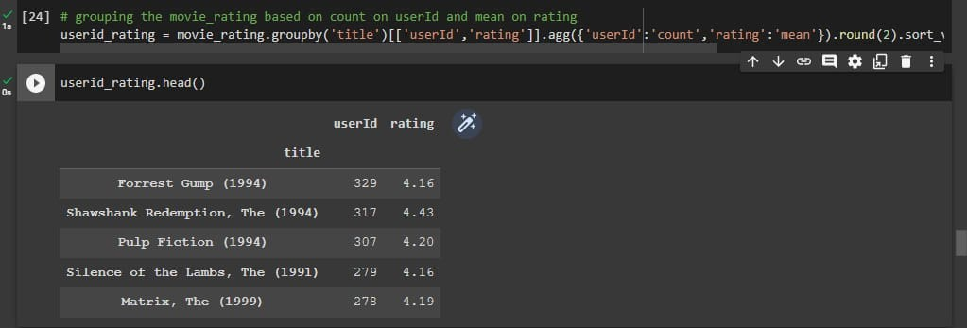
Correlation with other movies from movie_rating_pivot:

Slide 19
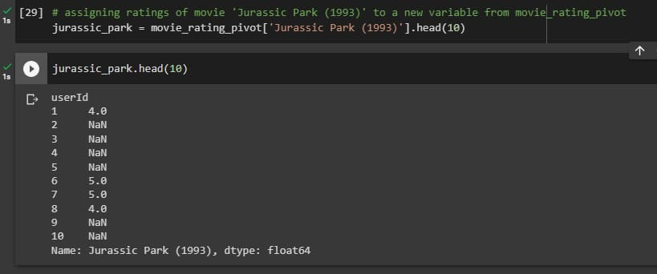
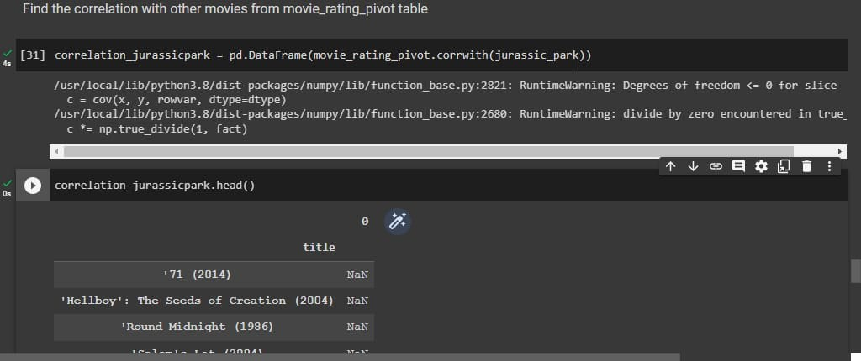

Slide 20
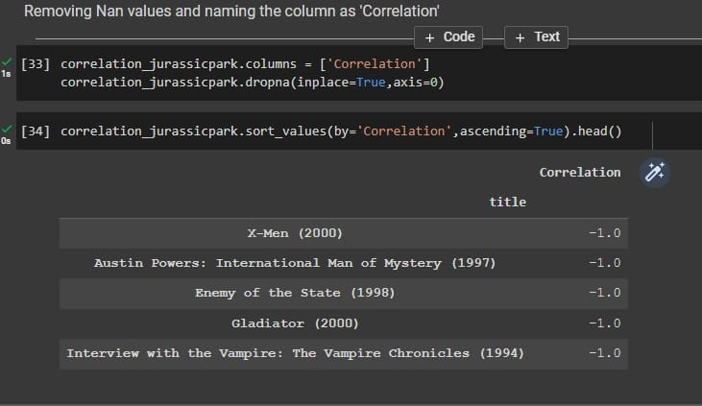
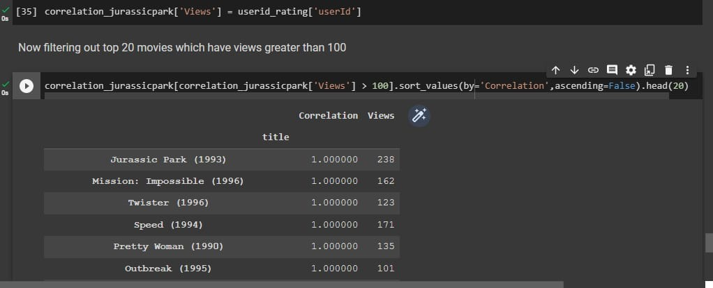

Slide 21
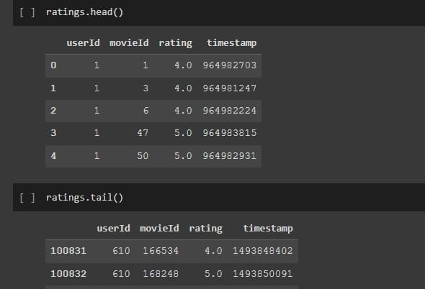

User based collaborative filtering:

Slide 22

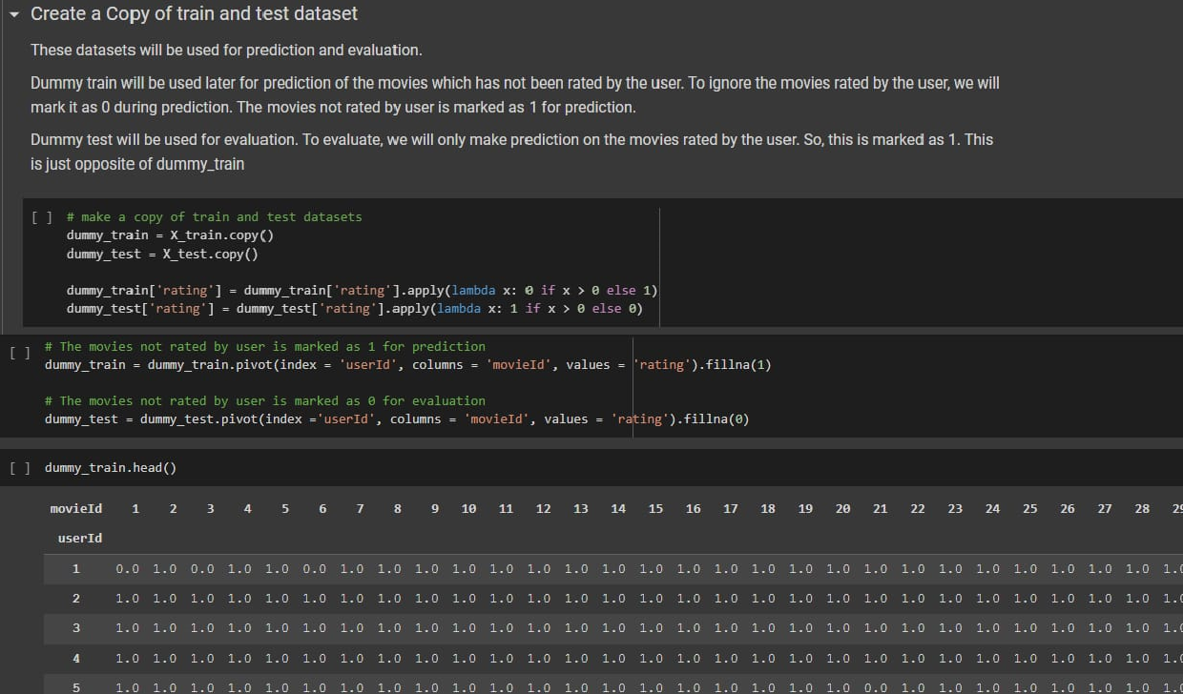


Training and testing dataset:

Slide 23
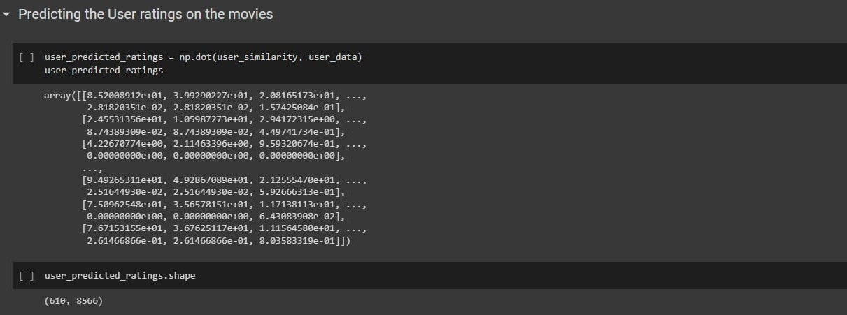
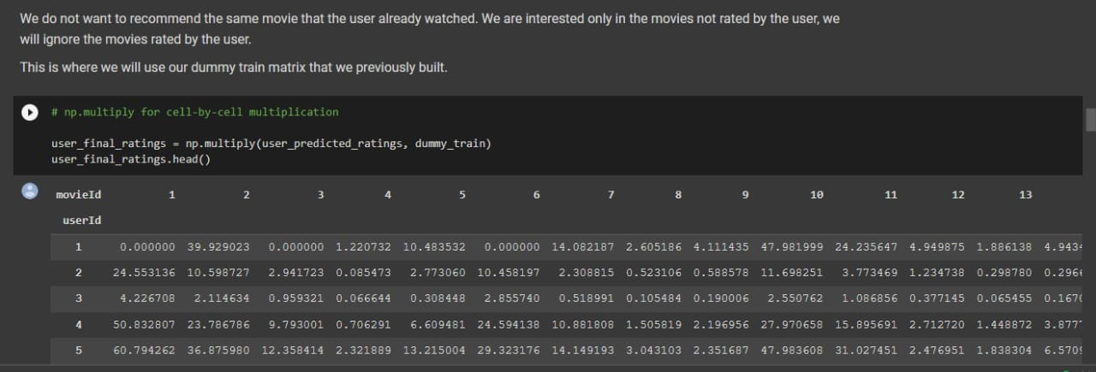

Slide 24

Observation :
First, we import all the python modules.
Then we have imported dataset.
Then we have undergone exploratory data analysis
Then data visualization which provides an excellent way to see and understand trends, outliers, and patterns in data.

Slide 25
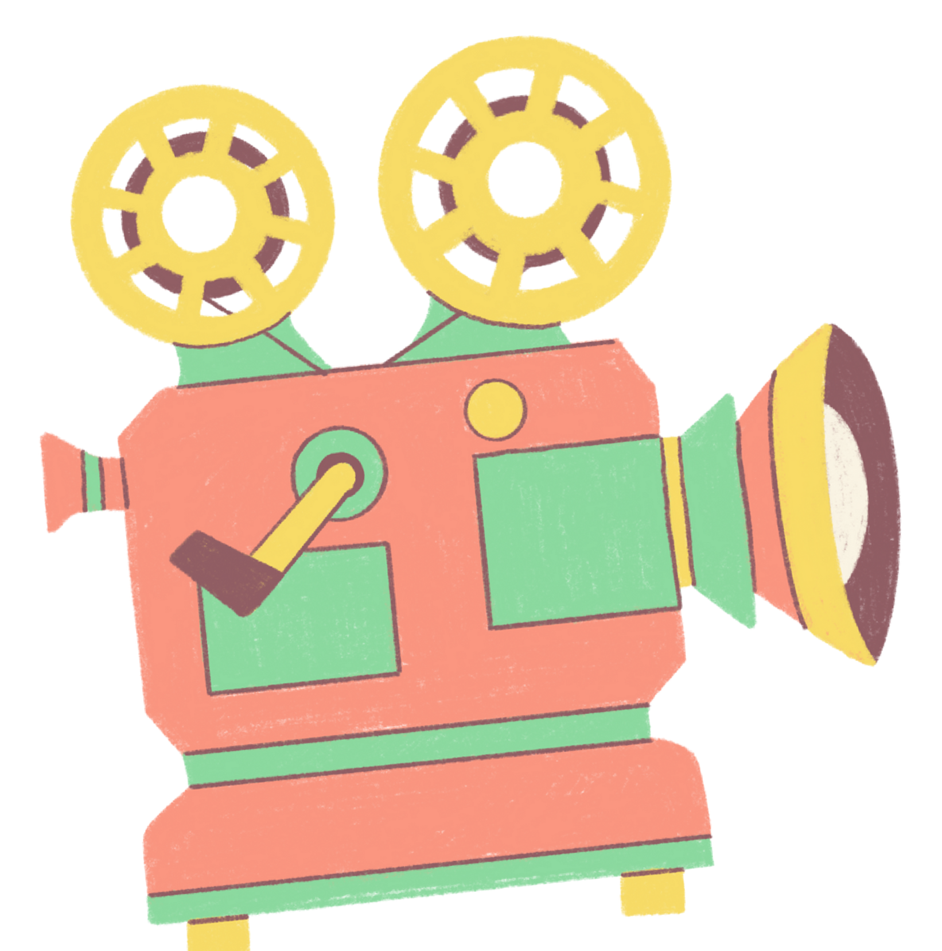
Conclusion:
Recommendation systems provide content for us by taking what other people recommend as well as our selections into account.
Collaborative Filtering is a widely used solution for this problem which we make use of in our project

Slide 26

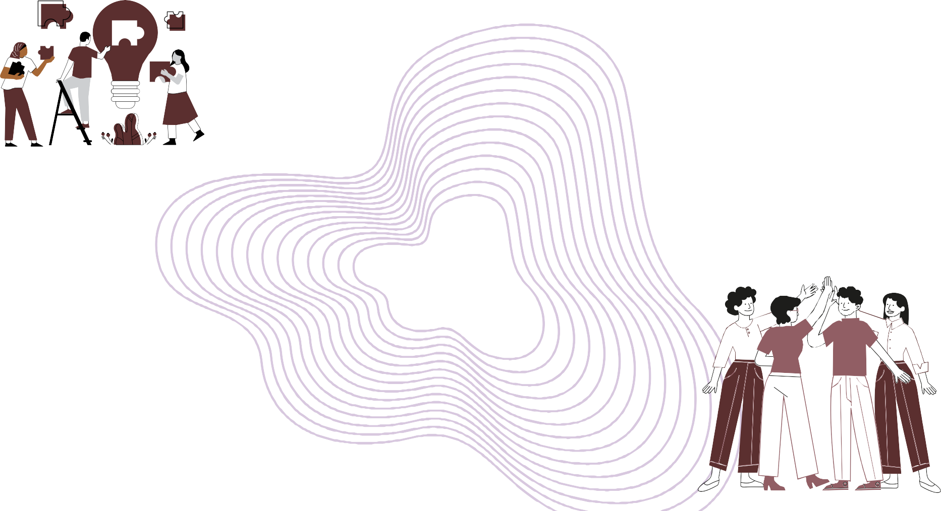
Contributions:
Kamalika Saha- Building recommendation system, user based and item based collaborative filtering.
Sweety Nag - Building recommendation system,data analysis.
Priyadarshini Sen - Presentation Making.
Monami Ghosh - Presentation Making.
Annesha Basu - Documentation.
Greeny Kundu - Documentation.

Slide 27

Thank you!
We hope y'all enjoyed the presentation.

